Slide 1
BHARAT NET SERVICE GRAM PANCHAYAT ( GOVERNMENT DATASET)
Source: https://www.data.gov.in/ Dataset: BHARAT NET SERVICE GRAM PANCHAYAT Email: maanvimaligireddy409@gmail.com LinkedIn: https://www.linkedin.com/in/maanvi-maligireddy- 6aa634336?

Slide 2
INTRODUCTION
Bharat Net Service Ready Gram Panchayats dataset highlights the progress of broadband connectivity in rural areas under the Bharat initiative. It provides data on the number of Gram Panchayats (GPs) and those that are service-ready across different districts and states.
Our main focus is to analyze service readiness, identify regions with low connectivity, and understand patterns to support decision-making for further broadband expansion.

Slide 3
DATASET OBSERVATION:
When we first looked at the Bharat Service Ready Gram Panchayats dataset, it wasn’t perfect—there were some missing values, inconsistencies, and things that needed a little fixing before we could make sense of the data. Here’s how we cleaned it up and what we found along the way.
Dealing with Missing Values We noticed that some values for service-ready Gram Panchayats were missing. Instead of deleting those entries, we filled them with the median value. Using the median helps prevent extreme values from skewing the data.
Checking Data Types and Converting Units We ensured each column had the correct data type. Additionally, we added a new column to convert the number of Gram Panchayats into percentages to analyze the distribution better.
Removing Duplicates and Identifying Outliers We checked for duplicate rows and removed them. Outliers, like unusually high or low Gram Panchayat counts, were identified using box plots. This helped us clean up errors and better understand exceptional cases.

Slide 4
Key Observations:
There are no missing values in the State, Total Gram Panchayats, or Service Ready Gram Panchayats columns.
One record has a missing district name, which may require further review.
The data provides a clear overview of service readiness by district, making it useful for evaluating connectivity progress and planning further expansions.

Slide 5
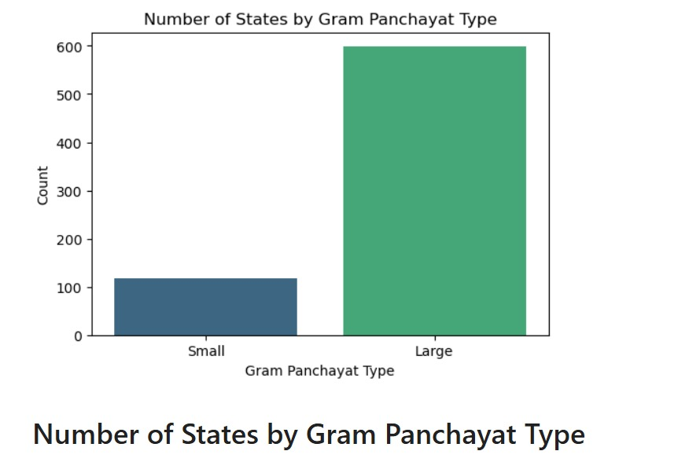
Comparison of States by Gram Panchayat Type
State-wise Distribution of Gram Panchayat Types

Slide 6
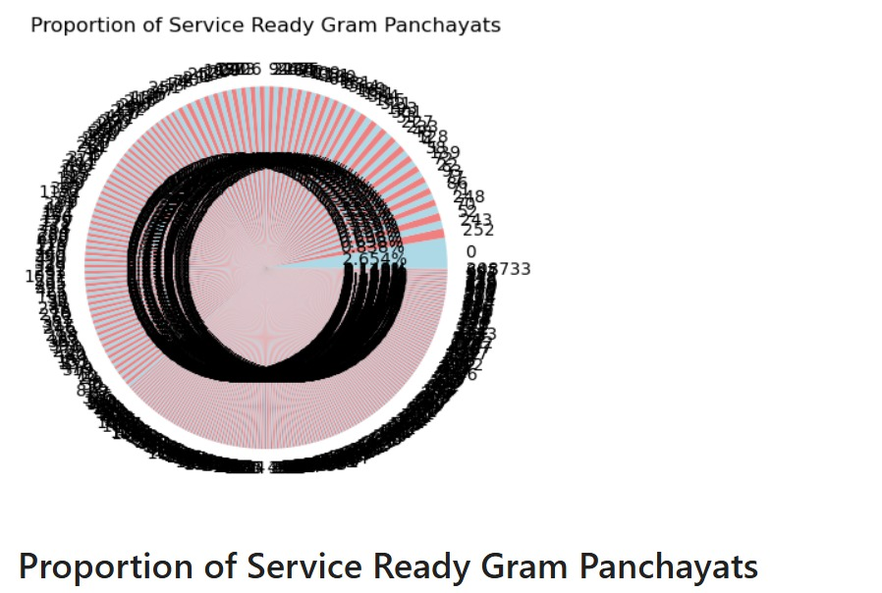
State-wise Distribution of Gram Panchayat Types
State-wise Distribution of Gram Panchayat Types

Slide 7
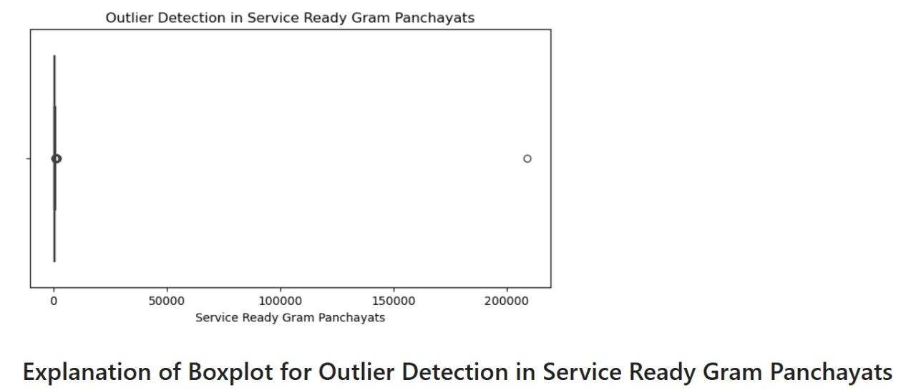
Explanation of Boxplot for Outlier Detection in Service-Ready Gram Panchayats
Outlier Detection Analysis of Service-Ready Gram Panchayats Using a Boxplot

Slide 8
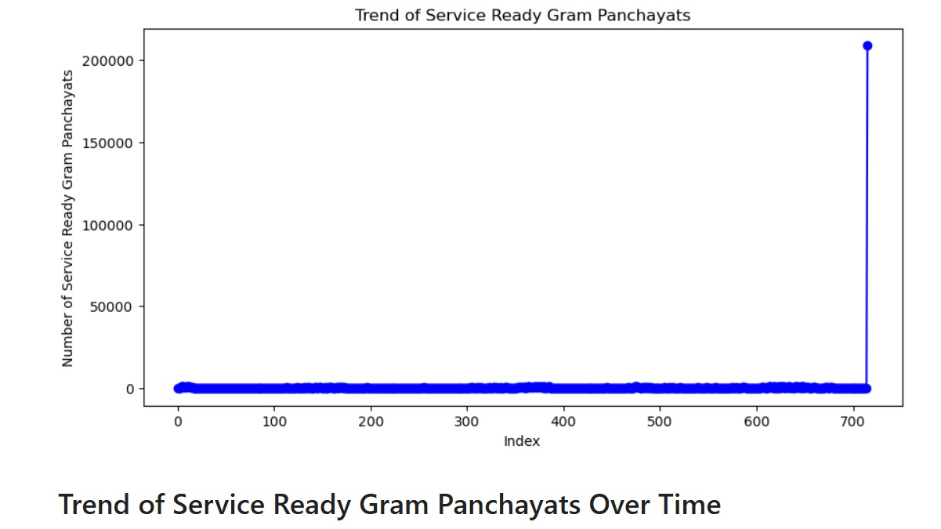
Trend Analysis of Service Ready Gram Panchayats Over Time
Trend of Service Ready Gram Panchayats Over Time

Slide 9
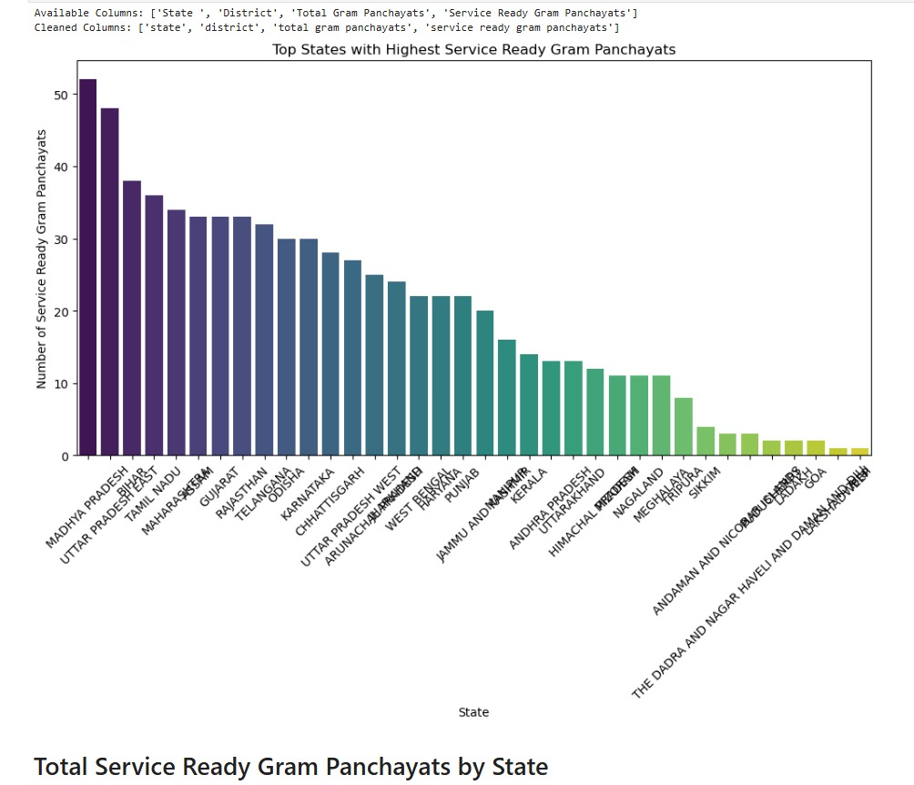
Top States with the Highest Number of Service Ready Gram Panchayats
State-Wise Service Ready Gram Panchayats

Slide 10
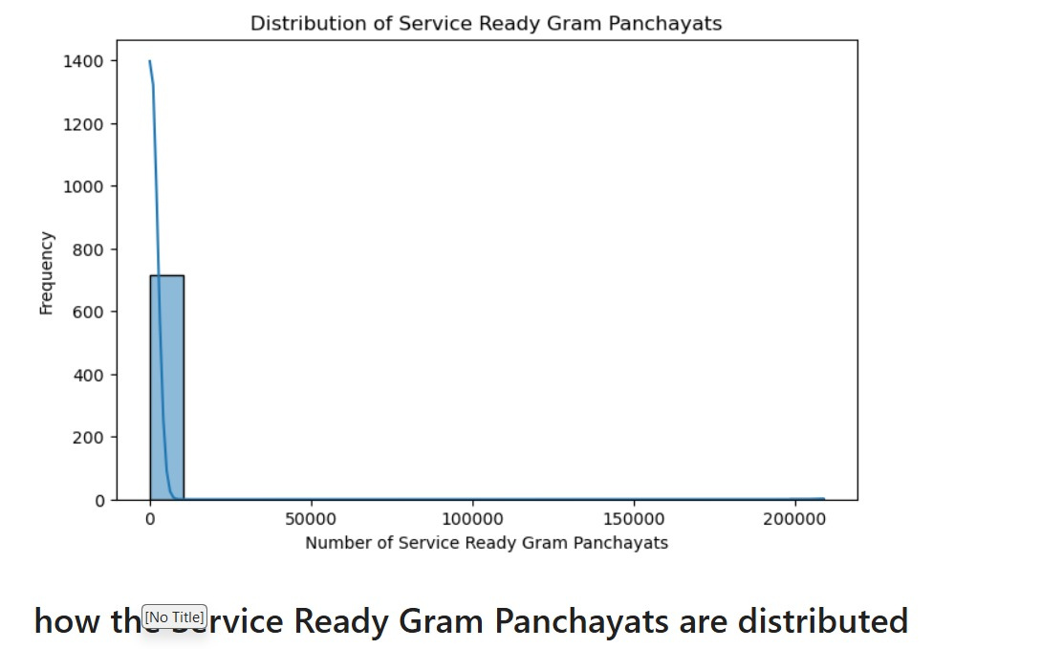
Distribution Analysis of Service Ready Gram Panchayats
The Distribution of Service Ready Gram Panchayats

Slide 11
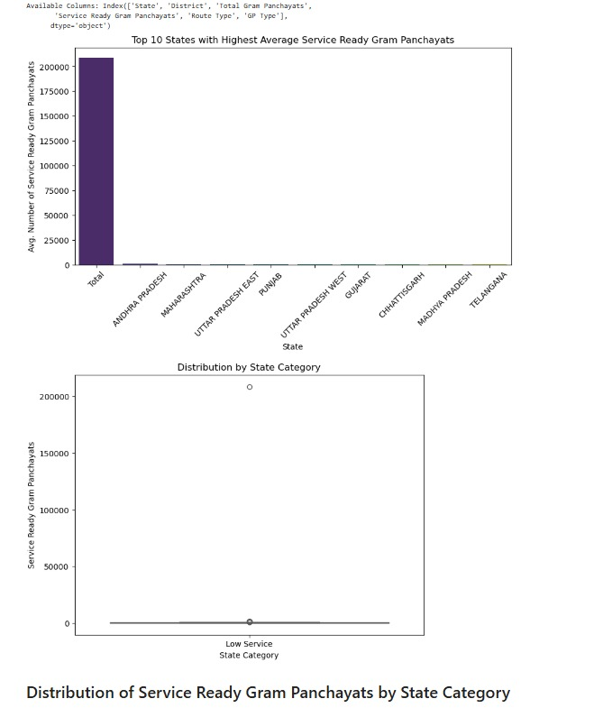
Analysis of State-Wise Distribution of Service Ready Gram Panchayats
Distribution of service ready panchayats by state category

Slide 12
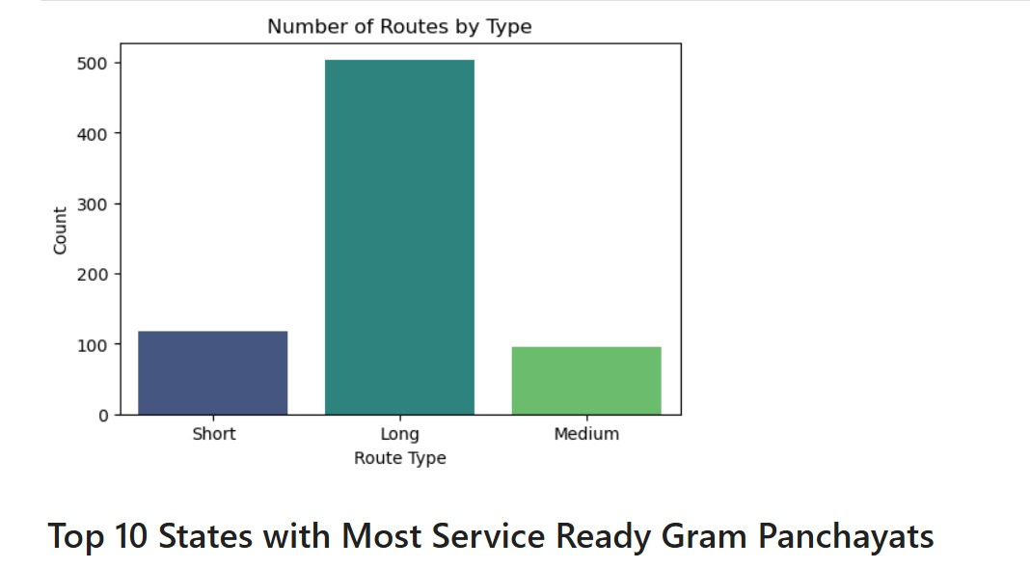
Comparison of Route Types by Count for Service Ready Gram Panchayats
Top 10 states with most service ready gram panchayats

Slide 13
DATASET OBSERVATION: When we first looked at the Bharat net Service Ready Gram Panchayats dataset, it wasn’t perfect—there were some missing values, inconsistencies, and things that needed a little fixing before we could make sense of the data. Here’s how we cleaned it up and what we found along the way.
Dealing with Missing Values We noticed that some values for service-ready Gram Panchayats were missing. Instead of deleting those entries, we filled them with the median value. Using the median helps prevent extreme values from skewing the data.
Checking Data Types and Converting Units We ensured each column had the correct data type. Additionally, we added a new column to convert the number of Gram Panchayats into percentages to analyze the distribution better.
Removing Duplicates and Identifying Outliers We checked for duplicate rows and removed them. Outliers, like unusually high or low Gram Panchayat counts, were identified using box plots. This helped us clean up errors and better understand exceptional cases.

Slide 14
5.Categorizing States into Different Tiers Instead of treating all states equally, we grouped them into categories:
Low Service States (less than 500 service-ready GPs)
Medium Service States (500–1000 service-ready GPs)
High Service States (more than 1000 service-ready GPs) This gave us clearer insights into regional service readiness.
Adding Useful Features To make the data more insightful, we added:
State Count: The number of service-ready GPs per state.
Moving Average: A smoother representation of trends over time.
What the Visuals Told Us
Bar Plot (Total Service Ready GPs per State)
Certain states had a significantly higher number of service-ready Gram Panchayats.
A few states contributed most to the overall service readiness.
Box Plot (Service Ready GPs by State Category)
Some states displayed a wide range of values, indicating uneven service implementation.
Outliers showed states with exceptionally high or low numbers.
Line Plot (Service Ready GPs Trend Over Time)
The number of service-ready Gram Panchayats fluctuated, but the general trend was upward. Pie Chart (Top 5 States with the Most Service Ready GPs)
A few states accounted for the majority of the service-ready Gram Panchayats, indicating their leading role in implementation.

